Slide 1
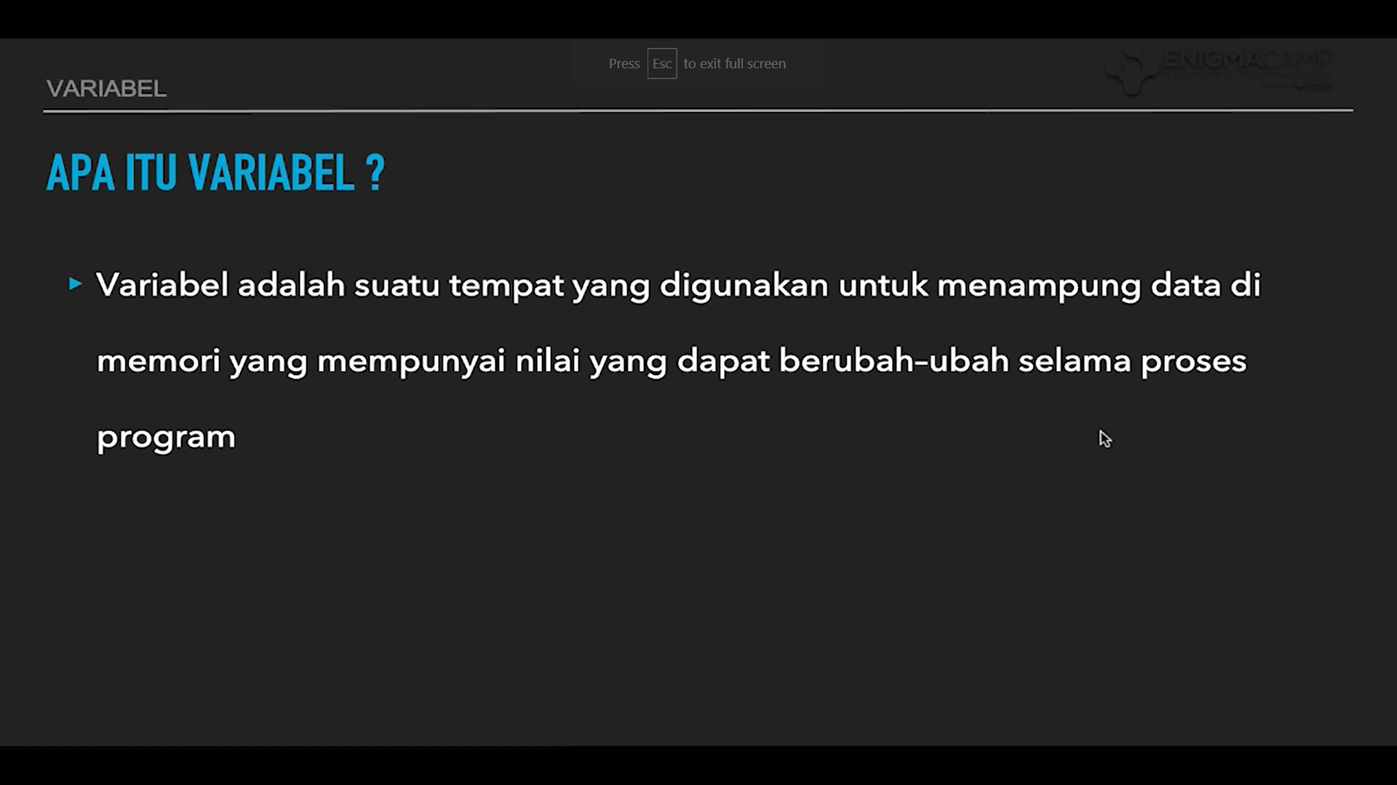

Slide 2
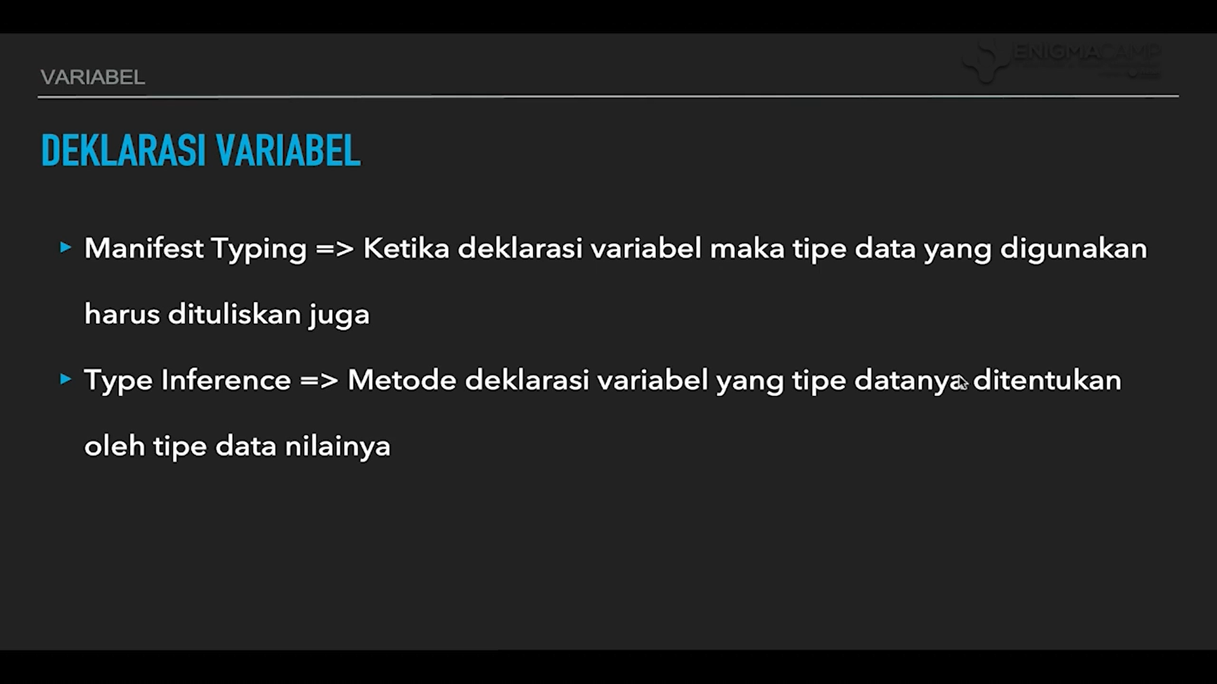

Slide 3
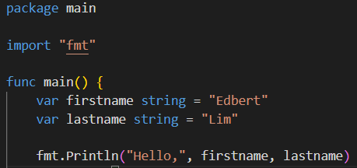
Creating Variables at GoLang
syntax: var variableName type
example: var firstName string

Slide 4
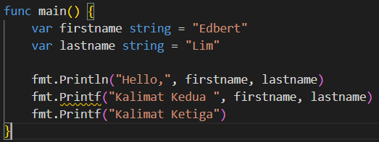
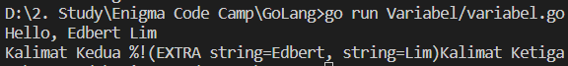
Println and Printf
Println: normally output it to terminal in new line.
Printf: output it at current line and will also output any error and data.

Slide 5
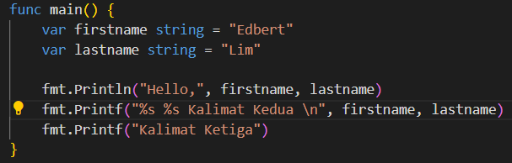

Using printf with regex
%s = get the incoming first string data
%d = get the integer data
\n= create new line

Slide 6
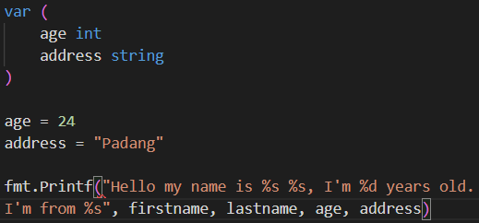

Using printf with regex
You can also declare multiple variables.
WARNING: in GoLang if you use printF with new line at the development code it will create error!

Slide 7
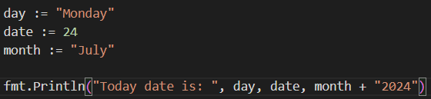
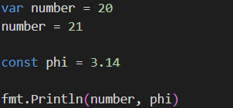
Type Inference Variable
We can declare variables with := which the type will be define depending on the value we assigned.
You can also declare type inference variable with var only just like javascript
and of course GoLang have constant variables

Slide 8
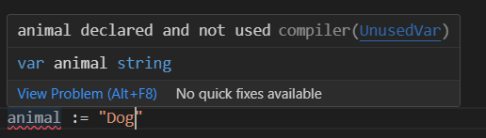
If variable declared but not used
A waning about variables in GoLang: once you declred a variable but never use it.
It will produce error

